Slide 1
Cryptography and System Security (CSS)
T.E – Sem.-VI
-Ms. Nabanita Mandal

Slide 2
Substitution Ciphers
It can be categorized as:
  Monoalphabetic Cipher
    Additive Cipher
    Shift Cipher
    Caesar Cipher
    Multiplicative Cipher
    Affine Cipher
  Polyalphabetic Cipher
    Autokey Cipher
    Playfair Cipher
    Hill Cipher
    Vigenere cipher
Notes:
In this section and the next, we examine a sampling of what might be called classical encryption
techniques. A study of these techniques enables us to illustrate the basic approaches to
symmetric encryption used today and the types of cryptanalytic attacks that must be anticipated.
The two basic building blocks of all encryption techniques: substitution and transposition.
We examine these in the next two sections. Finally, we discuss a system that combine both
substitution and transposition.

Slide 3
Polyalphabetic Ciphers
In polyalphabetic substitution, each occurrence of a character may have a different substitute.
The relationship between a character in the plaintext to a character in the ciphertext is one-to-many.
The key stream k=(k₁,k₂,…) in which each k_{i} is used to encipher the ith character in the plaintext to create the ith character in the ciphertext
Notes:
In this section and the next, we examine a sampling of what might be called classical encryption
techniques. A study of these techniques enables us to illustrate the basic approaches to
symmetric encryption used today and the types of cryptanalytic attacks that must be anticipated.
The two basic building blocks of all encryption techniques: substitution and transposition.
We examine these in the next two sections. Finally, we discuss a system that combine both
substitution and transposition.

Slide 4
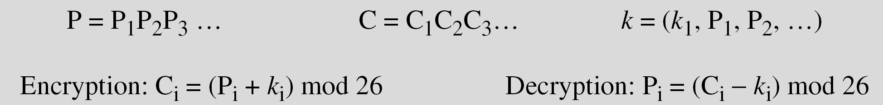
Autokey Ciphers
The key is a stream of subkeys in which each subkey is used to encrypt the corresponding character in the plaintext
The name of this cipher implies that the subkeys are automatically created from the plaintext cipher characters during the encryption process
Notes:
In this section and the next, we examine a sampling of what might be called classical encryption
techniques. A study of these techniques enables us to illustrate the basic approaches to
symmetric encryption used today and the types of cryptanalytic attacks that must be anticipated.
The two basic building blocks of all encryption techniques: substitution and transposition.
We examine these in the next two sections. Finally, we discuss a system that combine both
substitution and transposition.

Slide 5
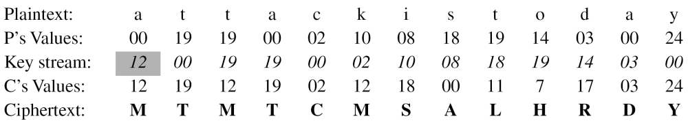
Autokey Ciphers
Assume that Alice and Bob agreed to use an autokey cipher with initial key value k1 = 12. Now Alice wants to send Bob the message “Attack is today”. Enciphering is done character by character.
Notes:
In this section and the next, we examine a sampling of what might be called classical encryption
techniques. A study of these techniques enables us to illustrate the basic approaches to
symmetric encryption used today and the types of cryptanalytic attacks that must be anticipated.
The two basic building blocks of all encryption techniques: substitution and transposition.
We examine these in the next two sections. Finally, we discuss a system that combine both
substitution and transposition.

Slide 6
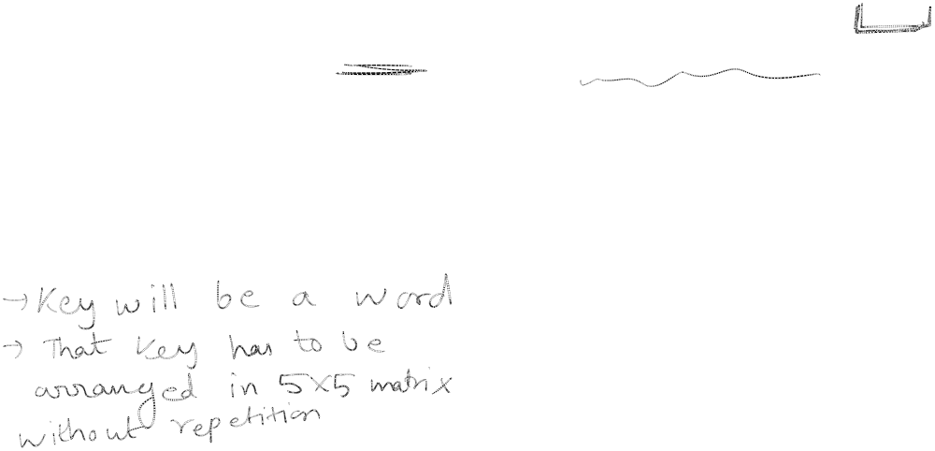
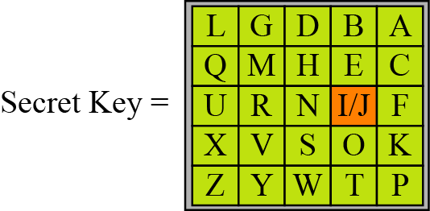
Playfair Ciphers
The secret key in this cipher is made of 25 alphabets arranged in a 5X5 matrix (letters I and J are considered same while encrypting)
Different arrangements of the letters in the matrix can create many different secret keys
Notes:
In this section and the next, we examine a sampling of what might be called classical encryption
techniques. A study of these techniques enables us to illustrate the basic approaches to
symmetric encryption used today and the types of cryptanalytic attacks that must be anticipated.
The two basic building blocks of all encryption techniques: substitution and transposition.
We examine these in the next two sections. Finally, we discuss a system that combine both
substitution and transposition.

Slide 7
Playfair Ciphers
If two letters in a pair are located:
In the same row of the secret key, the corresponding encrypted key character is the letter next to it on the right in the same row
In the same column of the secret key, the corresponding encrypted key character is the letter beneath it on the right in the same column
Not in same row or column of the secret key, the corresponding encrypted key character is the letter that is in its own row but in the same column as the other letter
Notes:
In this section and the next, we examine a sampling of what might be called classical encryption
techniques. A study of these techniques enables us to illustrate the basic approaches to
symmetric encryption used today and the types of cryptanalytic attacks that must be anticipated.
The two basic building blocks of all encryption techniques: substitution and transposition.
We examine these in the next two sections. Finally, we discuss a system that combine both
substitution and transposition.

Slide 8
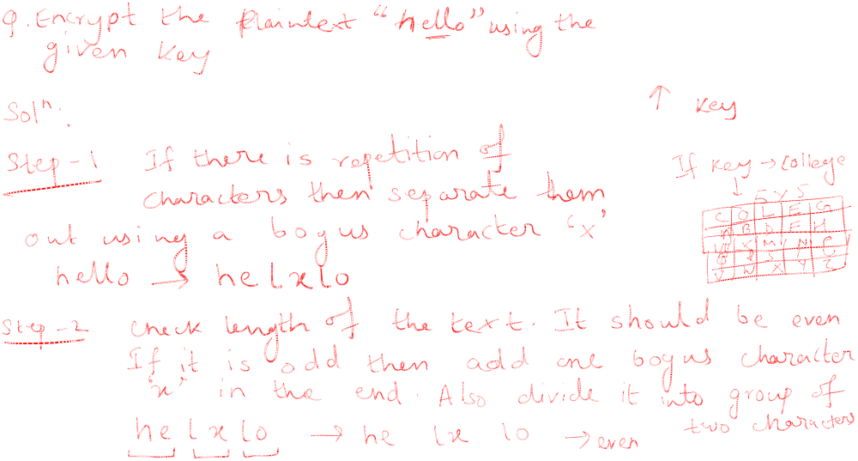
Playfair Ciphers
Notes:
In this section and the next, we examine a sampling of what might be called classical encryption
techniques. A study of these techniques enables us to illustrate the basic approaches to
symmetric encryption used today and the types of cryptanalytic attacks that must be anticipated.
The two basic building blocks of all encryption techniques: substitution and transposition.
We examine these in the next two sections. Finally, we discuss a system that combine both
substitution and transposition.

Slide 9
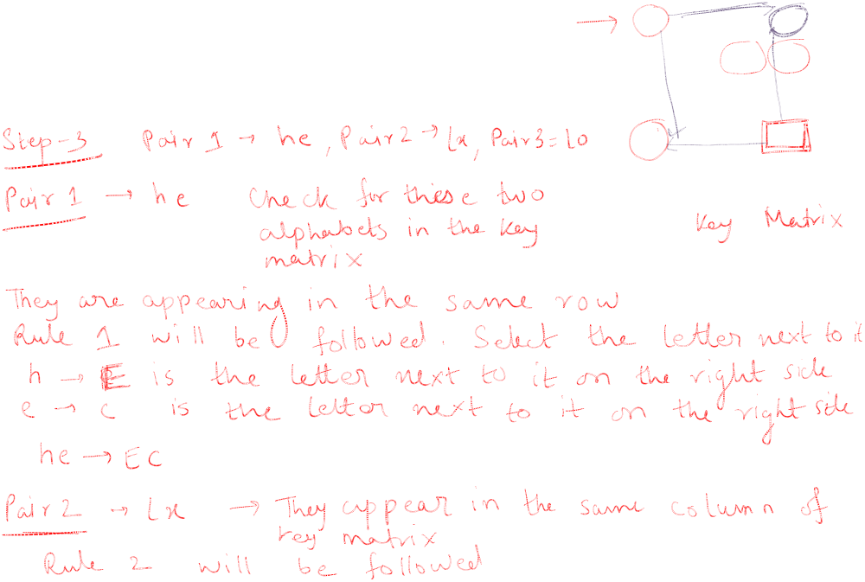
Playfair Ciphers
Notes:
In this section and the next, we examine a sampling of what might be called classical encryption
techniques. A study of these techniques enables us to illustrate the basic approaches to
symmetric encryption used today and the types of cryptanalytic attacks that must be anticipated.
The two basic building blocks of all encryption techniques: substitution and transposition.
We examine these in the next two sections. Finally, we discuss a system that combine both
substitution and transposition.

Slide 10
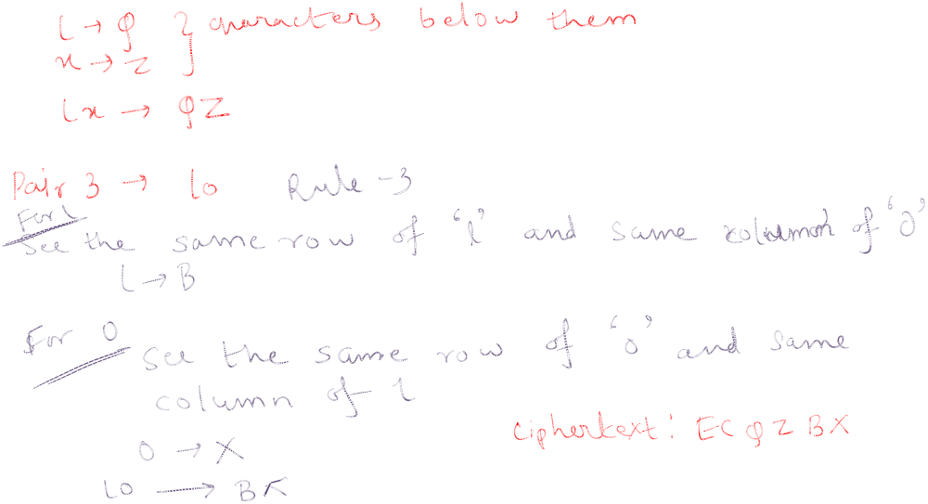
Playfair Ciphers
Notes:
In this section and the next, we examine a sampling of what might be called classical encryption
techniques. A study of these techniques enables us to illustrate the basic approaches to
symmetric encryption used today and the types of cryptanalytic attacks that must be anticipated.
The two basic building blocks of all encryption techniques: substitution and transposition.
We examine these in the next two sections. Finally, we discuss a system that combine both
substitution and transposition.

